Slide 1
Microsoft Power BI Self-Service BI Governance
Manish Wardekar
Director – WW Productivity, Business Analytics
manishw@microsoft.com

Slide 2
Session Overview
Why Governance
Personal, Team and Enterprise BI
What, Who and How
Roadmap
Other Questions

Slide 3
Nearly everyone across the organization engages with software
Yet, fewer than 25% of workers have access to analytical insights

Slide 4

What if you could empower everyone with analytics anywhere decisions are made?

Slide 5

Power BI
Experience your data. Any data, any way, anywhere
“With Power BI, it’s simple. Everything becomes possible.”
Philip Dean, Tees and Hartlepool National Health Services Trust

Slide 6
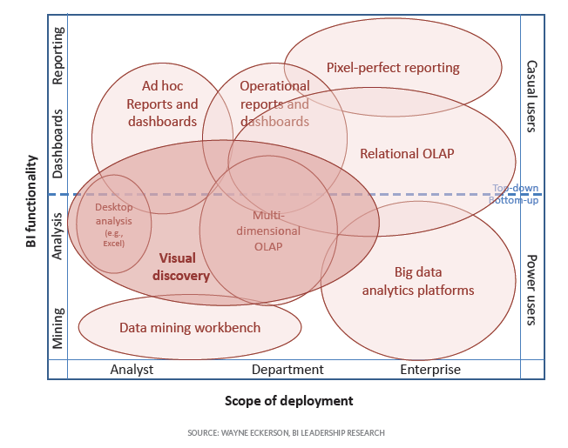
Power BI within Enterprise BI Strategy for Governed Data Discovery
Turning data into information, information into knowledge, knowledge into plans that drives profitable business decisions
Laying out long term foundation for Data Governance
Centralized Control vs. Decentralized Empowerment
Setting a holistic vision for departmental information management
Source: http://www.b-eye-network.com/blogs/eckerson/archives/2013/03/a_guide_for_bi.php
Notes:
To achieve a holistic, long-term vision, people, process, and technology must all be explicitly addressed
Responsibilities should extend up and down the management chain
Without a shared sense of ownership, BI Governance is nearly impossible to implement and maintain
BI Governance is best thought of as a continuous improvement effort

Slide 7
Why Governance is Needed
Plan ahead for self-service BI success
Establish proper change management and training policies
Minimize fear and resistance of new technologies from business users
Proper governance processes
Increase user adoption
Drive infrastructure and technology decisions
Since both business and IT are involved, reduces risks

Slide 8
Implementing Governance
Balance the needs of IT and the business
Every enterprise is unique
Customized governance to environment and culture
Determine initial principles and goals
Clarify ownerships of business information and content
Develop an education strategy and ongoing support plan

Slide 9
What to Govern
Successful deployment of a managed self-service BI platform requires the following elements for governance:
Published source data and business data models
PowerBI.com sites or SharePoint farms, include server roles, content database and site collections etc.
Security standards for accessing source data, and business information in reports, Power BI Desktop and Excel

Slide 10
Governance Model
TIGHT CONTROLS
EDW
Push Down Content
Reporting Services
Permanent Record
Subject to Compliance
Business Unit
Dashboards, KPIs &
Scorecards
Push Up Content
Power BI Desktop
Excel or other Reports
Knowledge Management
Information Sharing
Departmental, Team or Group Reporting
Project Reporting
Personal/Private Views
Data Science Exploration
Personal Reporting
LESS CONTROLS

Slide 11
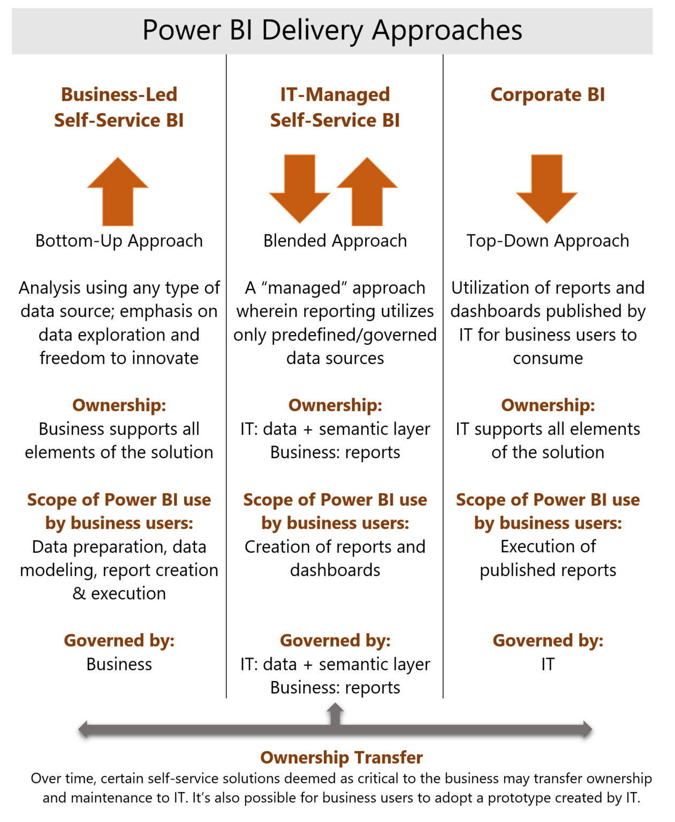
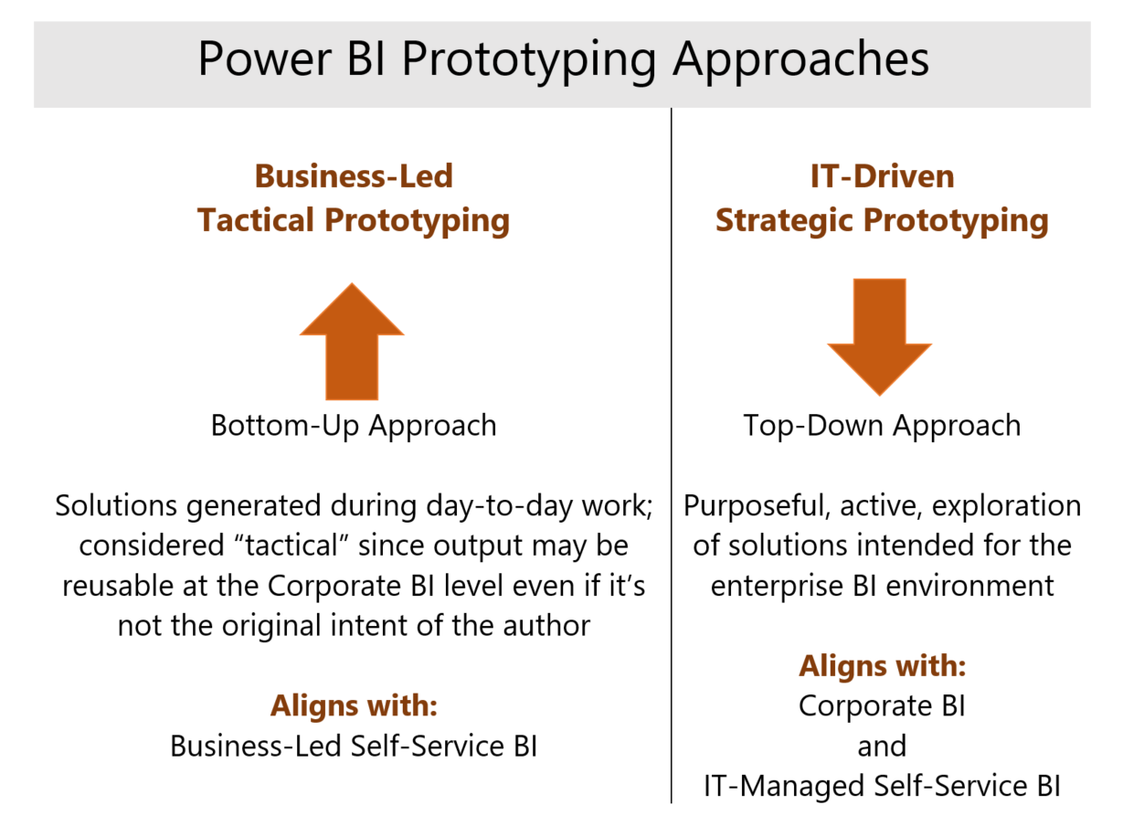
Power BI Governance White Paper

Slide 12
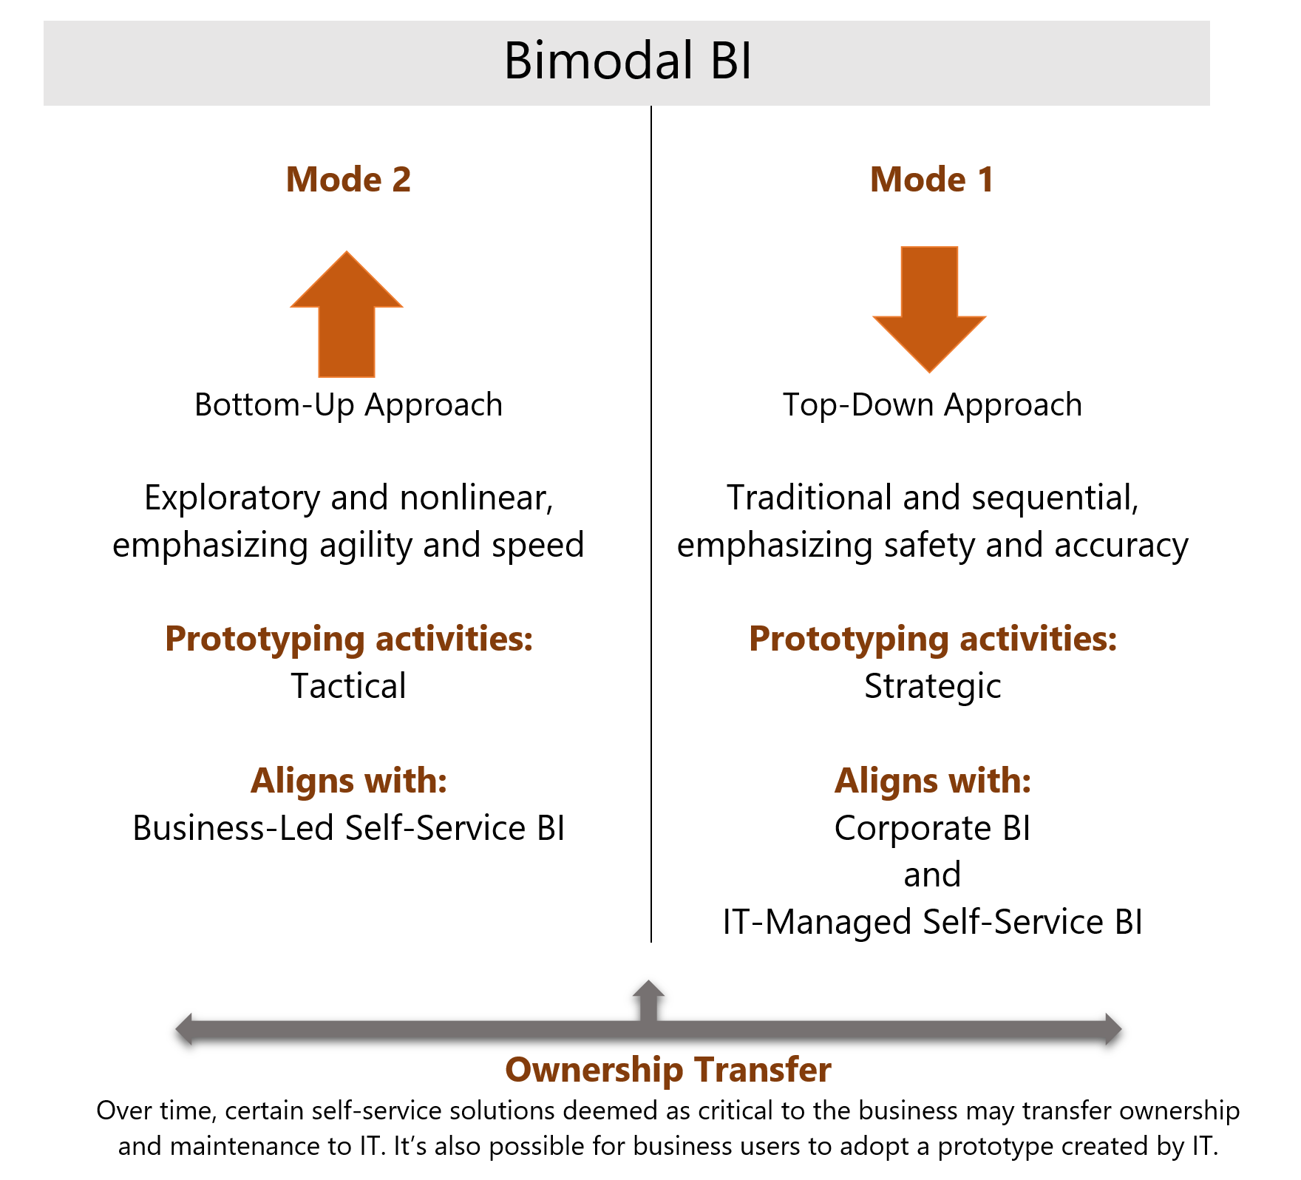

Slide 13
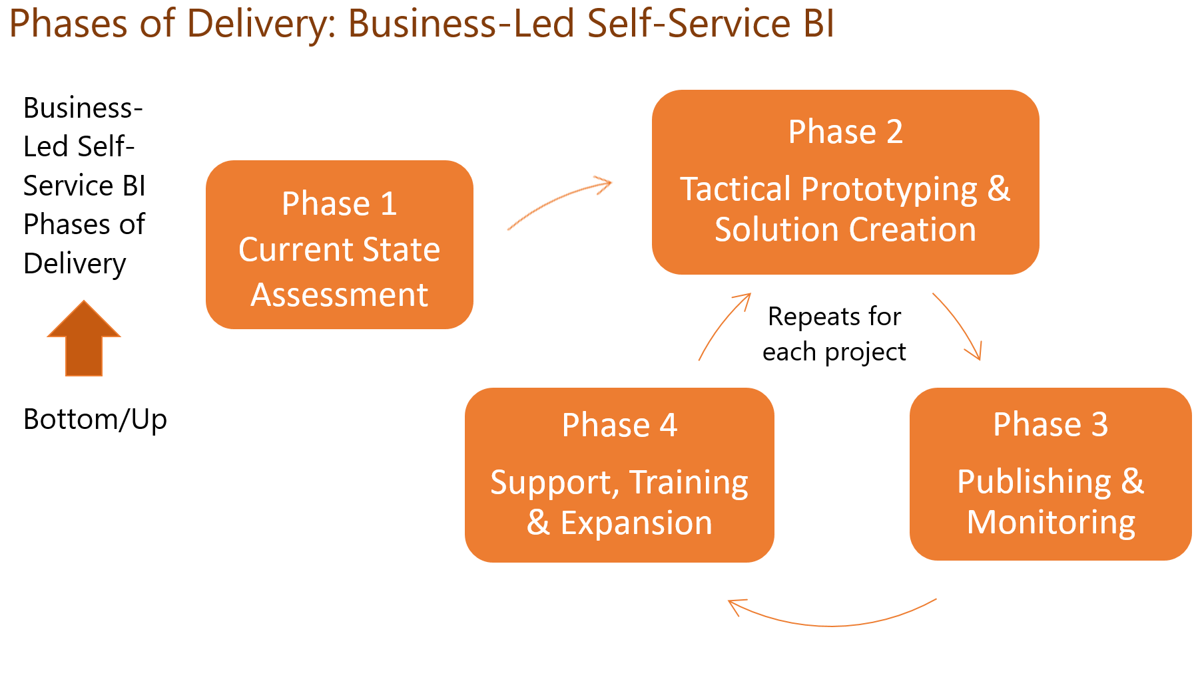

Slide 14
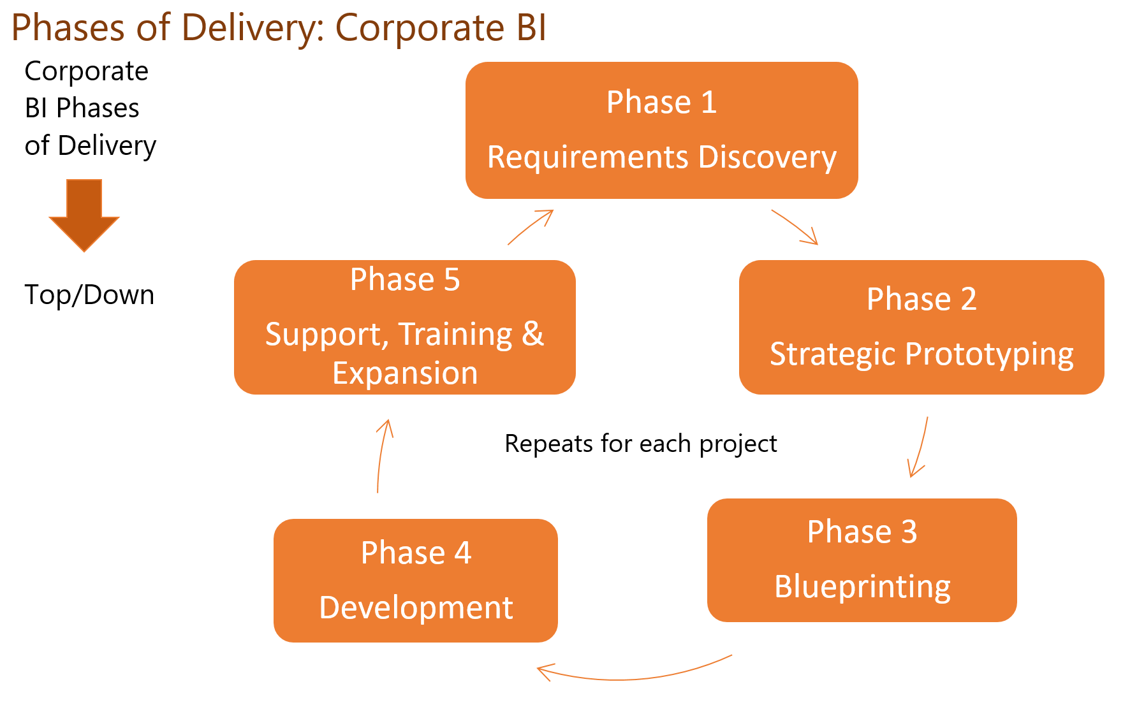

Slide 15

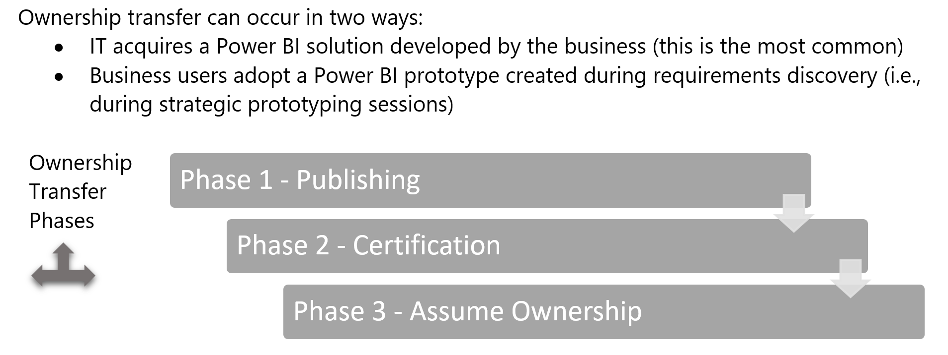

Slide 16


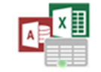
Example
1
Data Sources
6
PowerBI.com
Master Data & Data Quality
1
Add New Reporting Data Source
Organizational Content Packs
Shared Data Sources
Shared Datasets
Shared Data Models
Reports and Dashboards
Groups Workspaces
OneDrive for Business
SharePoint Lists
2
Perform Data Source Security and Governance Management Tasks
2
Data Governance Stewards
Big Data/Data Lake
Security, Roles, Data Sources, Data Catalog, Master Data Version Control and Audit
3
Publish Approved Shared Data Source for Analysts/Power Users
4
Develop Reporting Content with Approved Shared Data Sources
Cloud Apps, Streams & IoT Data
3
Approved Secure Shared Data Sources, Datasets
via Enterprise Data Gateway and/or Content Packs
7
Submit Reporting Content for Approval
based on Governance Guidelines
5
Approval Workflow to Deploy
6
Review, Approve/Disapprove, Add to Catalog for Compliance and Audit
Data Warehouse & App Databases
4
8
5
7
Publish Approved Content with Permissions to Groups
8
View and Explore Power BI Content based on Role/Group Permissions
Power BI Desktop,
Excel, R, Azure ML & other tools
Analysis Services
BI Semantic Models
Analysts/Power Users
Self-Service BI Users

Slide 17
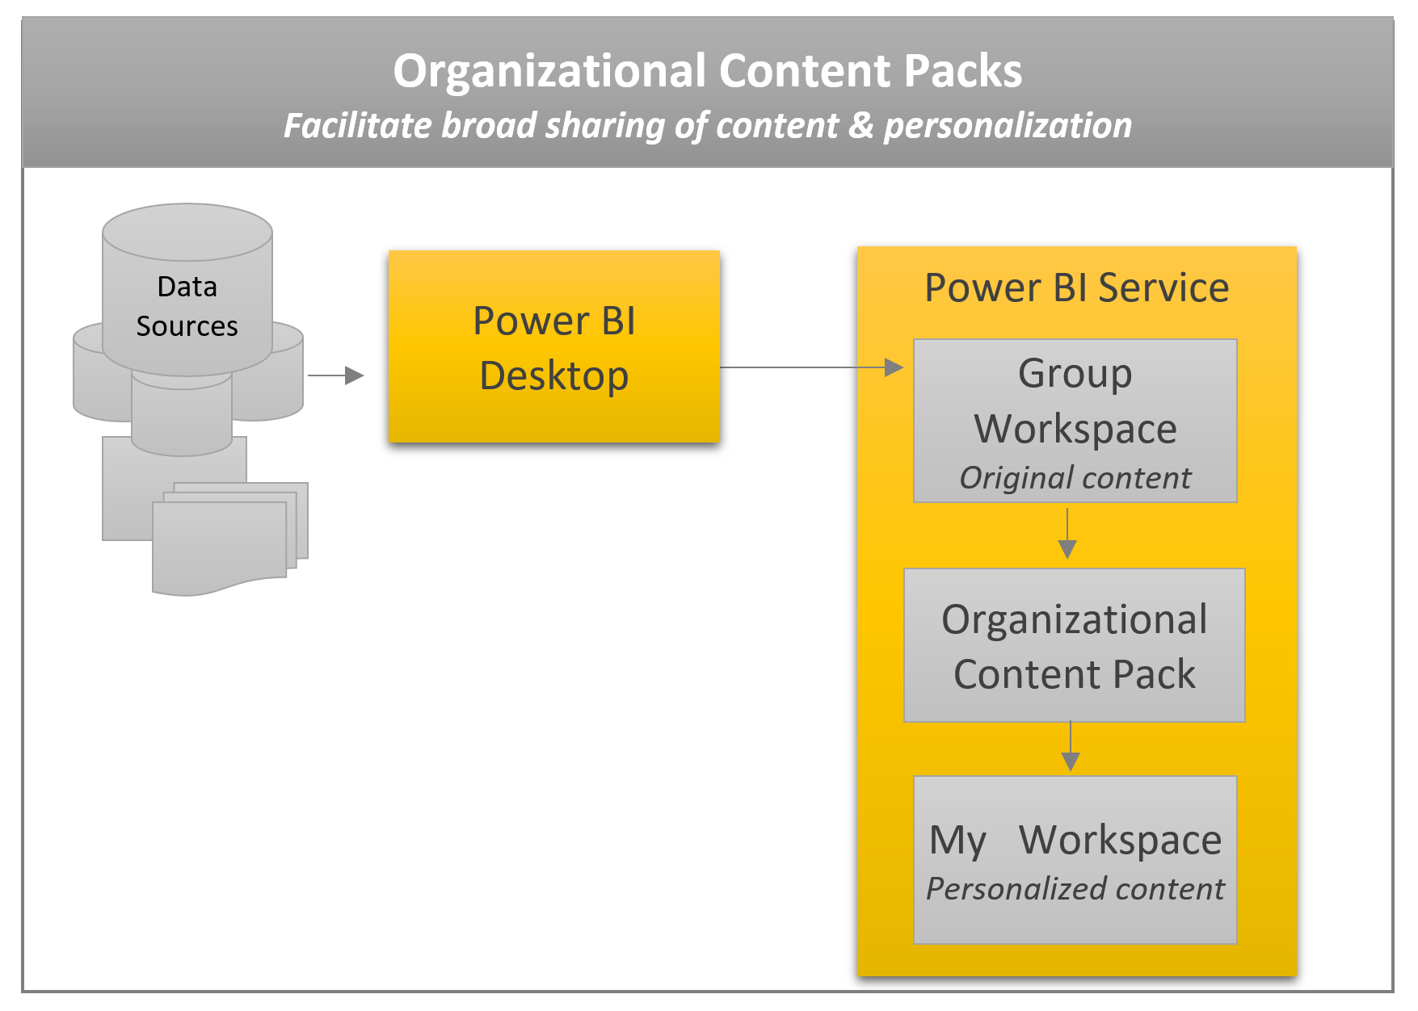

Slide 18
Who to Involve
Management Review Committee
Executive Management: Vision and Funding
Business owners willing to provide strategic insight and direction for building departmental BI solutions
BI Pros and IT: Security, Hosting, Operations and Support
Power Users: Responsible for the lifecycle of reporting and dashboard content

Slide 19
Launch with a Training Site
Post team and individual roles and responsibilities: IT, Operations, Support, and Power User roles
Operations and Data Security Policies
Self-Service BI Training
How To documentation and videos
Instructor-led training schedules

Slide 20
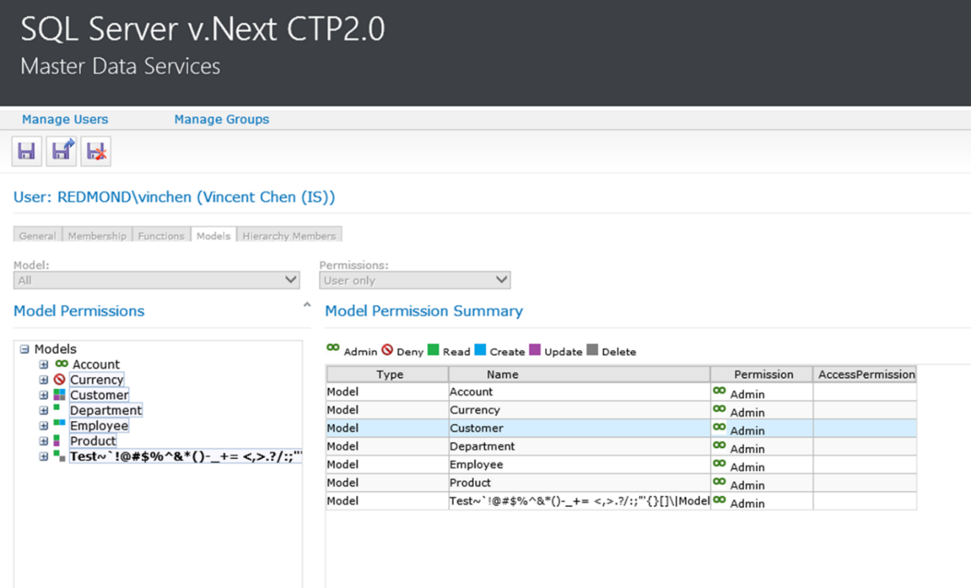
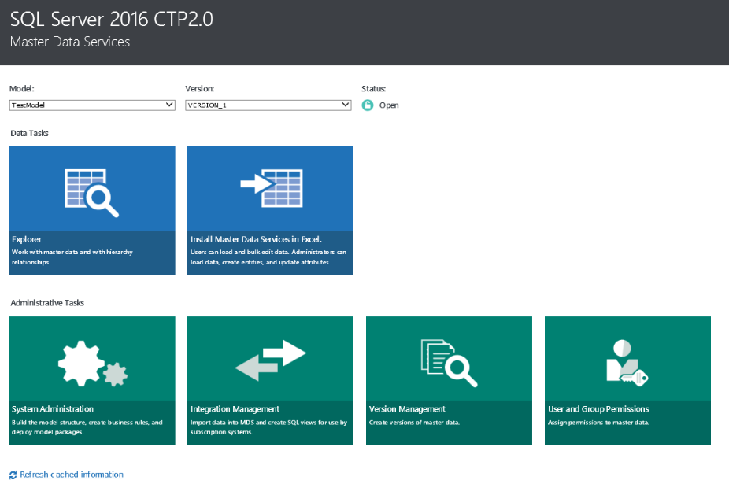
Master Data and Data Quality
IT prepared and cleansed enterprise-wide master data
Entity based master data structures (object mapping, reference data, and dimensions and hierarchies) used in data integration operations
MDS Add-in for Excel for organizational data stewards
Notes:
Master Data Services
Makes it easier for organizations to manage master data structures (object mapping, reference data, and dimensions and hierarchies) used in data integration operations.
With Entity Based Staging, DBAs can load all members and attribute values for an entity at one time.
Explorer and Integration Management functional areas of the Master Data Manager web application have been updated with a new look and feel.
MDS Add-in for Excel democratizes data management, so information workers have the ability to build data management applications directly in Excel.
Information workers can use this add-in to load a filtered set of data from the MDS database, work with the data in Excel, and then publish the changes back to the MDS database.
Improved in SQL Server 2016:
Performance and scale, manageability and monitoring, and security.
MDS model deployment has been enhanced to support bigger models.
Optional row-level compression per entity is now supported.
For manageability and monitoring, configurable retention settings for the transaction logs and reuse of entities across models is now supported.
More granular security permissions around read, write, delete, and create

Slide 21
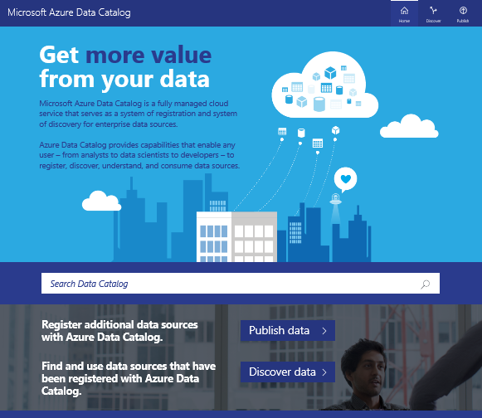
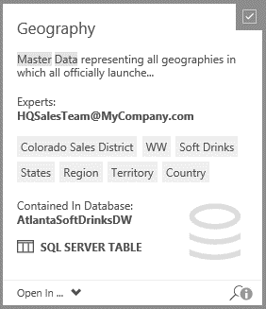
Enterprise Data Catalog
One stop reference directory for all Enterprise Data Assets
Data source directory containing metadata about your data
Currently copy connection strings; future integration with Power BI
Currently supports: Azure SQL Database, SQL Server, SSAS Multidimensional and Tabular, Oracle Database and SSRS Reports
Future extensibility API for 3rd parties to add new data sources
Notes:
One Stop Shop for all enterprise data sources: Central, powerful and intuitive experience across all data sources offering a single entry point for publishing, discovery and enterprise-wide oversight, management and analytics
Free version for Power BI users, upcoming premium version offering that will work with many popular data discovery tools in the market
No data movement, heavy up front investment: Often Data Discovery is associated with building a data lake. Data catalog is not a data lake, it’s a metadata store only where the data remains in the location where it was originally born. You just point to the source, extract metadata and the data source reference – building a map of pointers to data…. Data lakes are project oriented, they contain only data needed for given projects. Data catalog can reference ALL data in s single location and is complementary to data lakes – it helps users map which data lives where within the lake and can help the user understand the intended purpose
Any data source: Structured and unstructured - On premises and in the cloud - Microsoft and non-Microsoft: Oracle, SAP, Teradata, Hadoop, etc.
Also allows 3rd parties to add new data sources through an extensibility API

Slide 22
Enterprise Gateway
Secure and scalable enterprise data source publishing
IT managed, centralized way to publish data sources for transparent data refresh support
Built-in fail over and load balancing capabilities to meet the needs of large enterprises
Visibility into usage of data sources for monitoring and audit
Expanded direct connectivity to on-premises data without having to move their data to the cloud
Notes:
Secure and scalable way for IT to publish enterprise data to Power BI
The Power BI Enterprise Gateway enables IT departments to deploy and manage central gateways to serve a large group of users. It is the successor to the Data Management Gateway in Power BI for O365.
Centralized way to refresh content in Power BI – Instead of each employee installing and configuring a Personal Gateway, IT can configure, manage and maintain a group of Enterprise Gateways to transparently refresh data uploaded to Power BI for the business users and analysts requiring up-to-date data.
Load balancing and fail over – The Enterprise Gateway has built-in fail over and load balancing capabilities to meet the needs of large enterprises
BI governance – IT departments gain visibility into Enterprise Gateway usage, such as most commonly accessed data sources, and the users accessing them, empowering them to monitor and audit usage. For example: based on the usage of a particular data source IT might set the maintenance schedule to minimize user impact.
Live connection to Tabular and Multidimensional models – With the Enterprise Gateway, enterprises, who have invested in SQL Server Analysis Services Tabular or Multidimensional models, with fine grained security, can experience Power BI without having to move their data to the cloud.
DirectQuery over data sources –Enterprises can leverage the Enterprise Gateway to directly connect on-premises SQL Servers. More data sources are coming soon!

Slide 23



PowerBI.com
Administration
Azure Active Directory
Directory Synchronization
Manage Domains and Accounts
Manage login branding
Directory and Account management
Subscriptions and licenses
Creating groups and organization content packs
Roadmap: Enterprise IT management, usage monitoring and admin portal
Office 365
Manage Subscriptions
License Assignment
Manage Domains and Accounts
Create Groups
Create Organization Content Packs
Manage gateways
Notes:
Accounts and Groups are stored within Azure Active Directory
Subscriptions and licenses are managed via Office 365
Universal Groups are created via Power BI or other O365 apps such as Exchange Online.
Organization Content Packs are great to create a curated set of Dashboards, reports and data sets to share in your organization. When paired with groups, they enable great collaboration and flexibility to customize.
Support is present for O365 Dedicated customers as well as Power BI Pro being part of the Office 365 E5 offering.

Slide 24
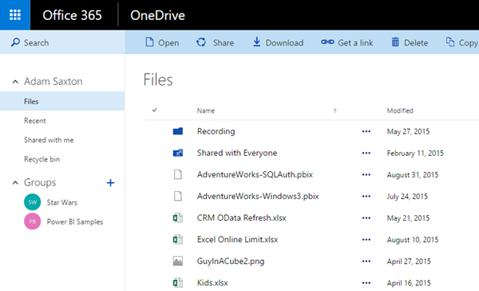
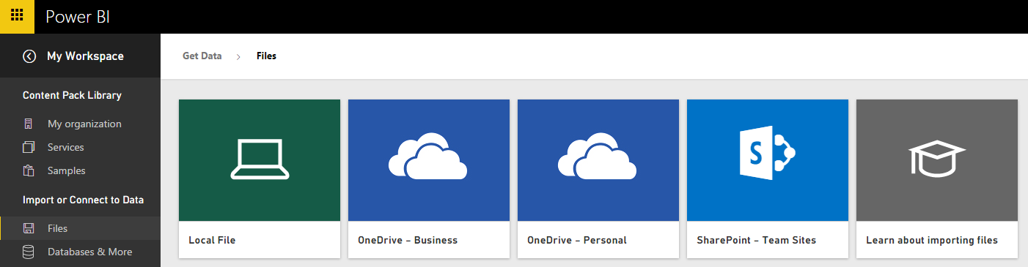
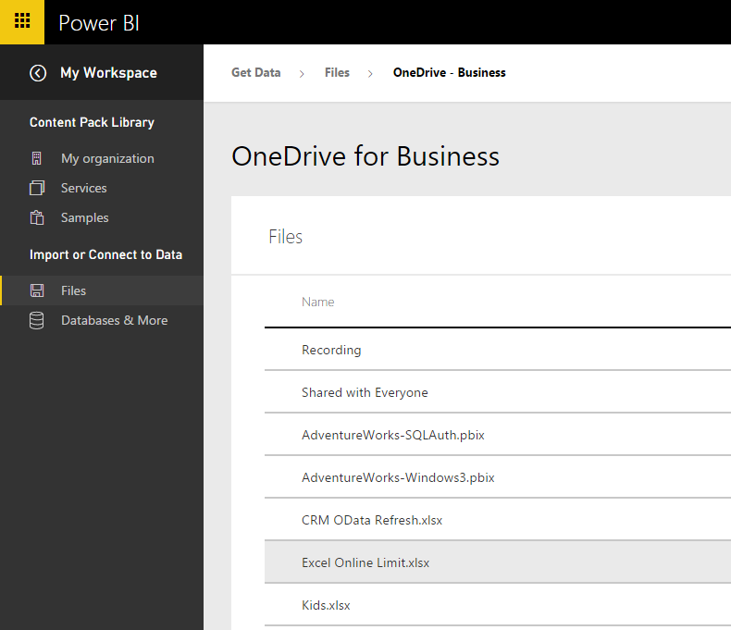
Development Lifecycle
OneDrive for Business or SharePoint Online for file storage
Version history
Organization Content Packs for curated data to share
Developer APIs for advanced usage
Roadmap: Content Pack health, errors and usage reporting

Slide 25
Resources / Specific Questions
On Premises Gateway
Performance across geographies
Performance Triggers, Scalability and HA
Power BI Desktop Monthly Updates
Restricting Access in Power BI - AngryAnalytics Blog
Power BI Auditing
Assigning Licenses
Row-level security (RLS) with Power BI
Power BI Security Whitepaper
How Microsoft IT Rolled out Power BI for Microsoft Employees

Slide 26
Roadmap

Slide 27
Questions

Slide 28

© 2014 Microsoft Corporation. All rights reserved. Microsoft, Windows, Windows Vista and other product names are or may be registered trademarks and/or trademarks in the U.S. and/or other countries.
The information herein is for informational purposes only and represents the current view of Microsoft Corporation as of the date of this presentation. Because Microsoft must respond to changing market conditions, it should not be interpreted to be a commitment on the part of Microsoft, and Microsoft cannot guarantee the accuracy of any information provided after the date of this presentation. MICROSOFT MAKES NO WARRANTIES, EXPRESS, IMPLIED OR STATUTORY, AS TO THE INFORMATION IN THIS PRESENTATION.

